Slide 1
Weekly meeting
5 16 2024
Ty Bottorff

Slide 2
Outline
Figure by figure comparison/reproducing/extending Erin’s P452 to P576

Slide 3
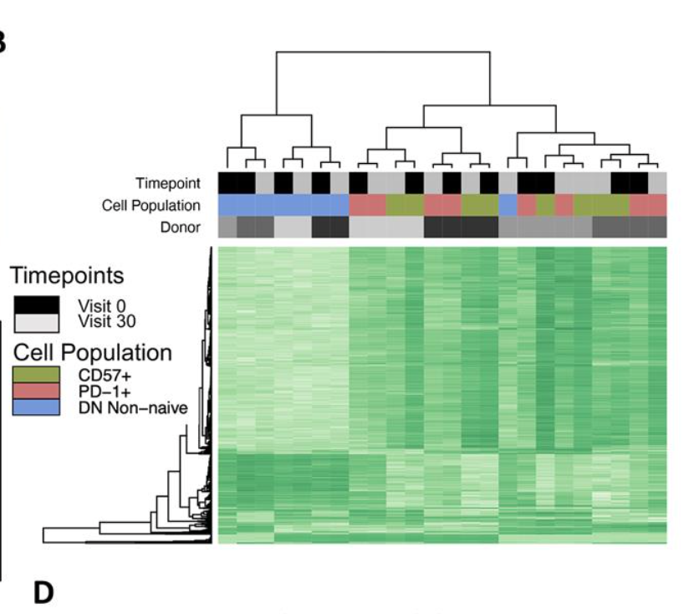
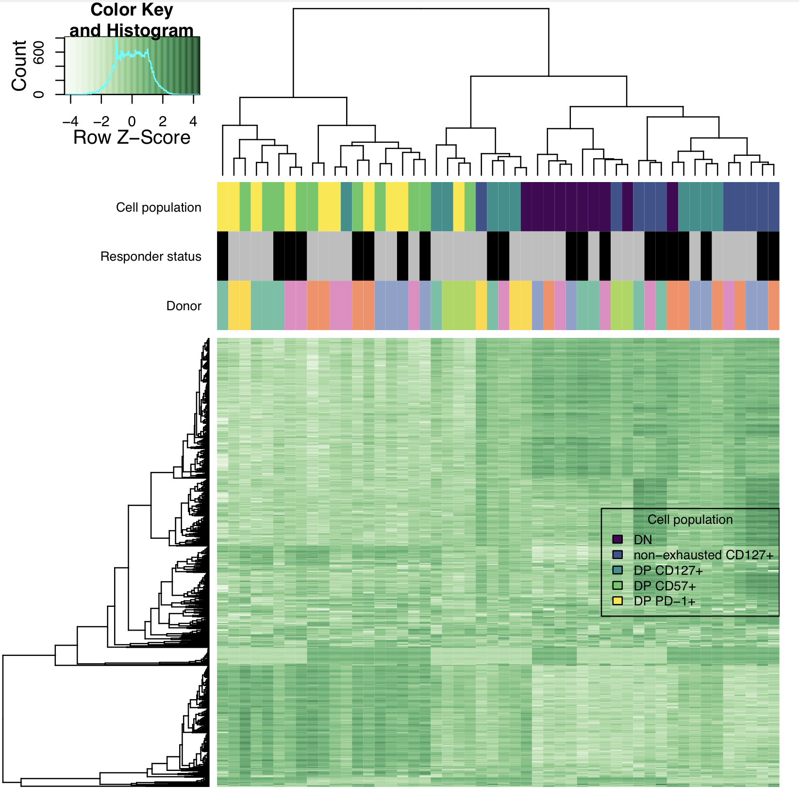
DP CD57⁺ and DP PD-1⁺ cluster together, away from DN in both projects, DP CD127⁺ seems to cluster separately (as do DN/non-exhausted CD127⁺) in P576
P576
P452 (Erin’s)

Slide 4
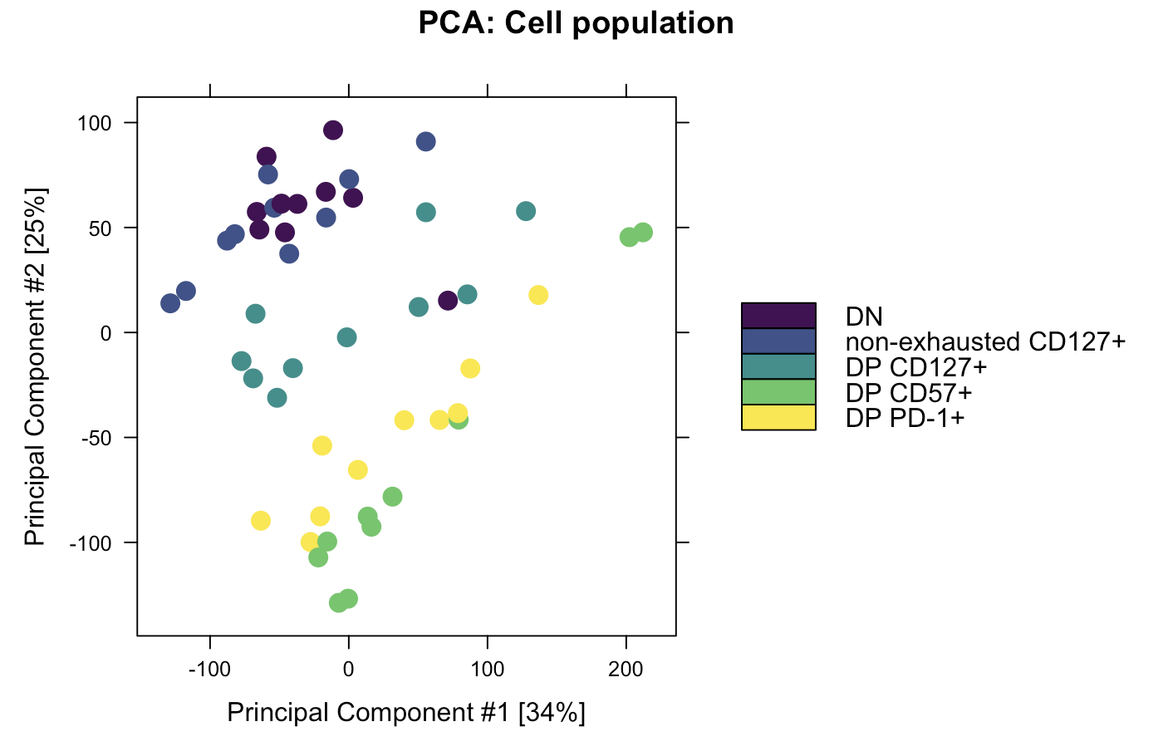
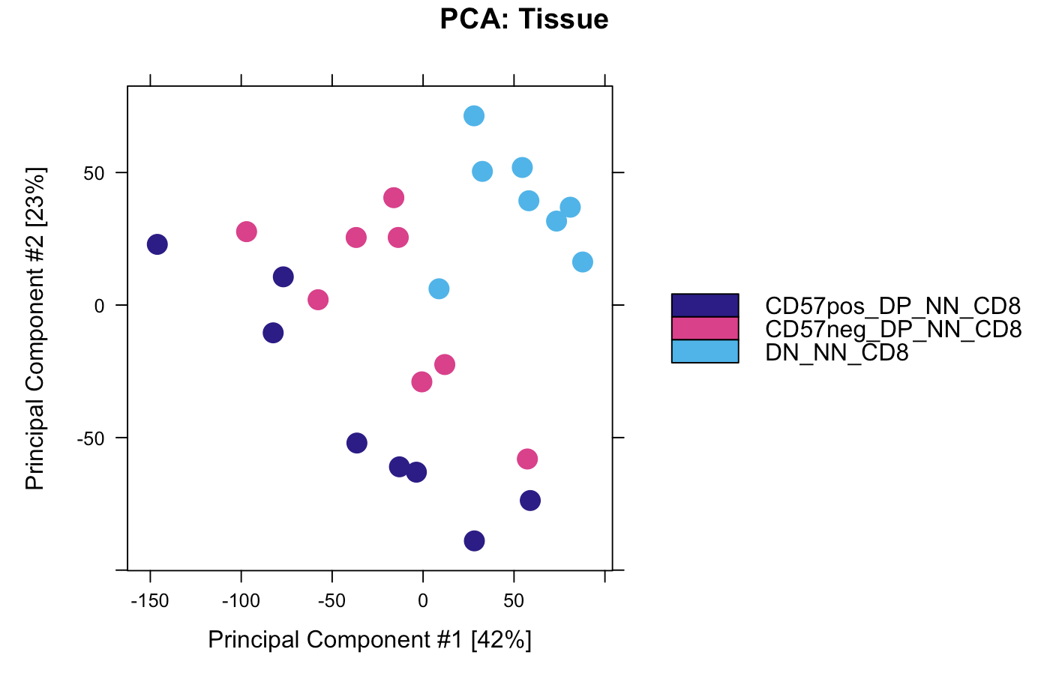
DP CD57⁺ and DP PD-1⁺ cluster together, away from DN in both projects, DP CD127⁺ seems to cluster separately (as do DN/non-exhausted CD127⁺) in P576
P576
P452 (Erin’s)
Notes:
Rows in heatmap are peaks?

Slide 5
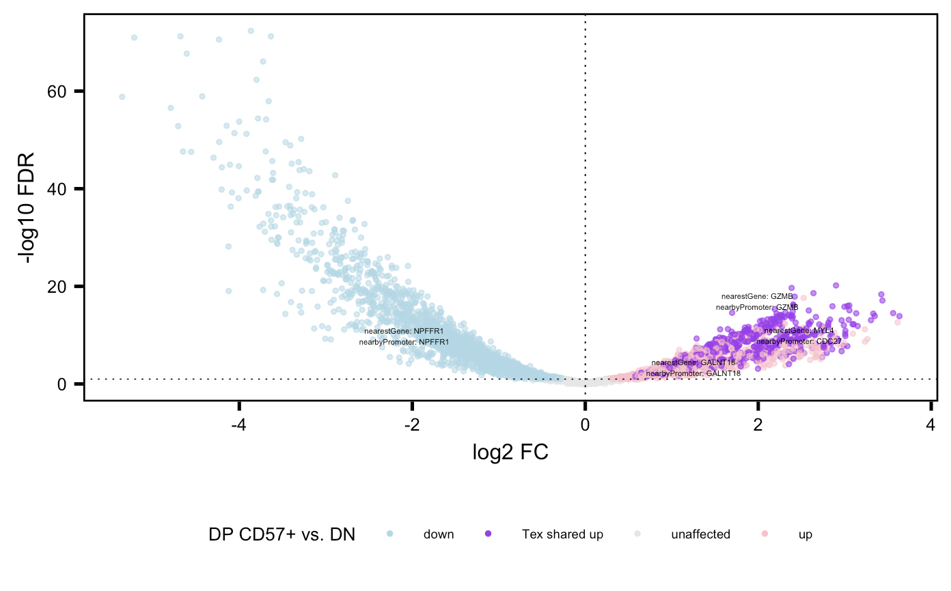
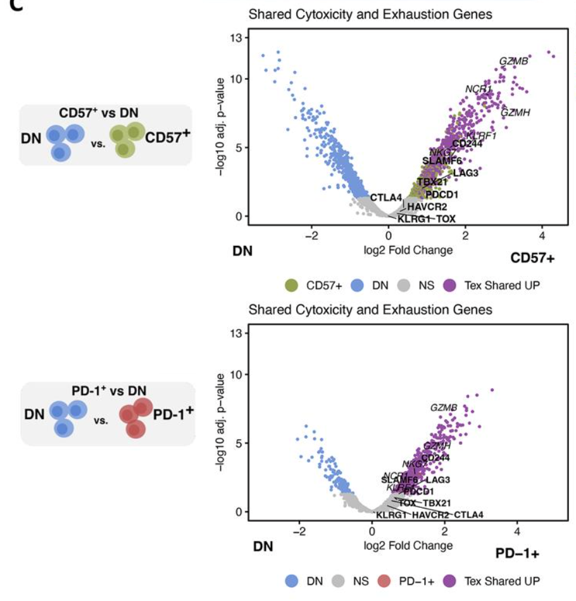
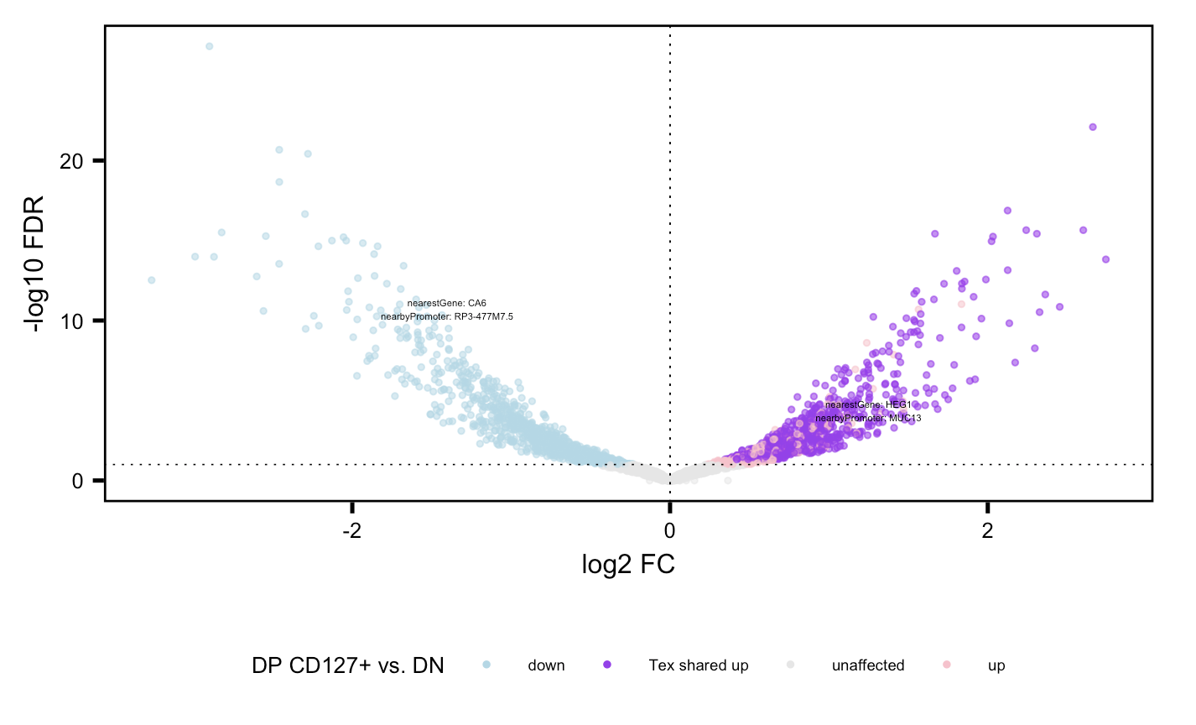
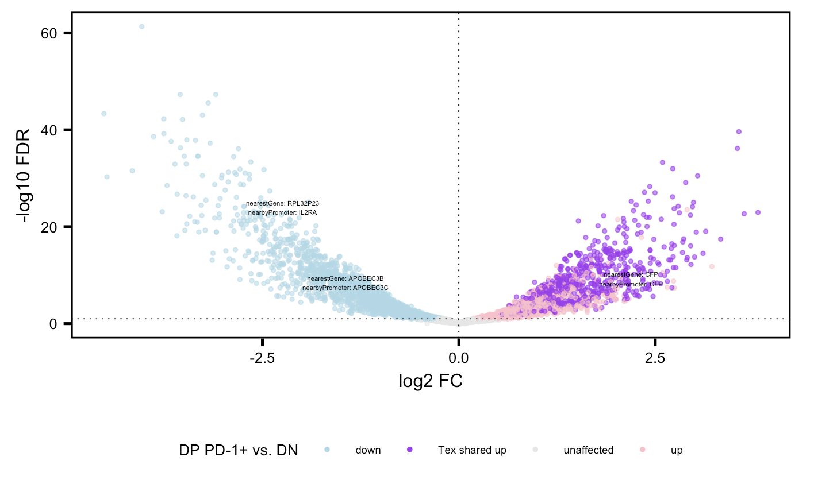
Do observe substantial closest gene to peak sharing between DP populations in both projects
P452
P576
Notes:
Methods:
1. Filter peaks for positive log2 FC and FDR < 0.05 in each sort vs. DN
2. then look for genes appearing at least once in all 3 lists = T_{ex} shared “up”
3. also filter peaks for VP by top abs(FC) for each gene (looks similar if by median FC peak)
Haven’t done but expect promoter colored purple/peak filtered to look similar

Slide 6
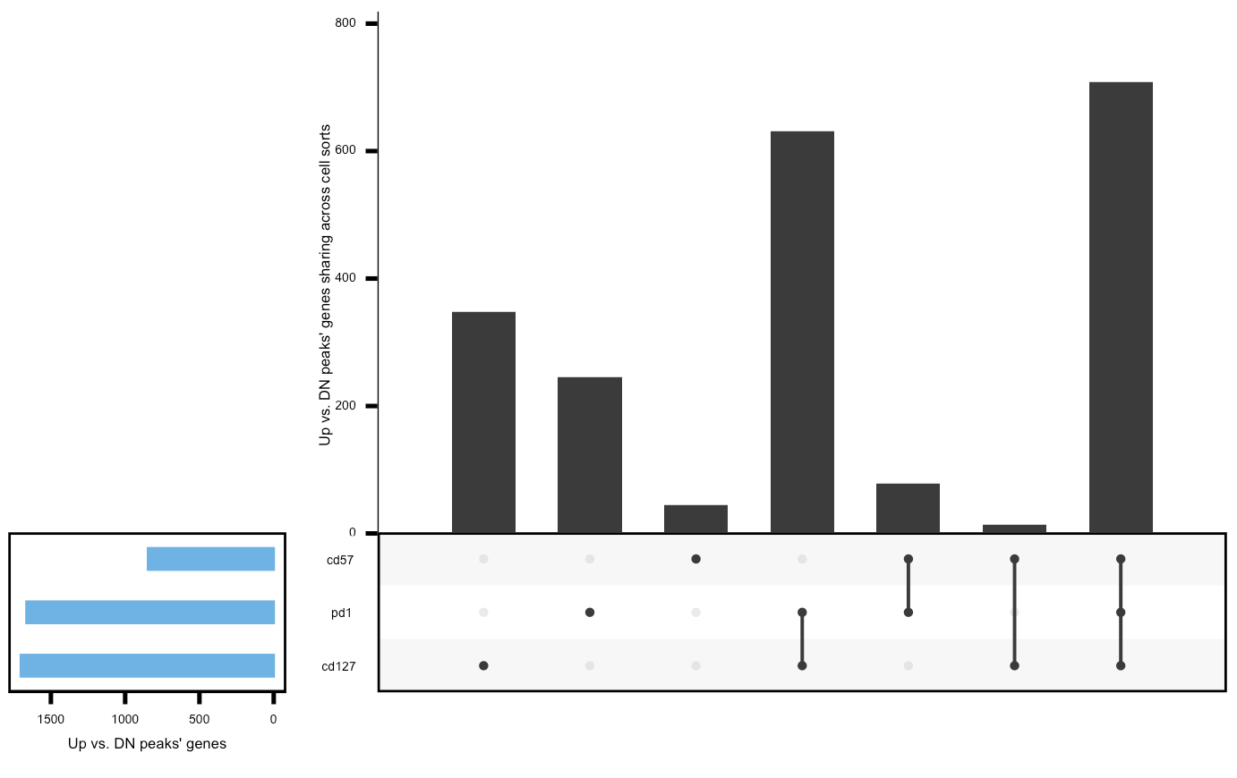
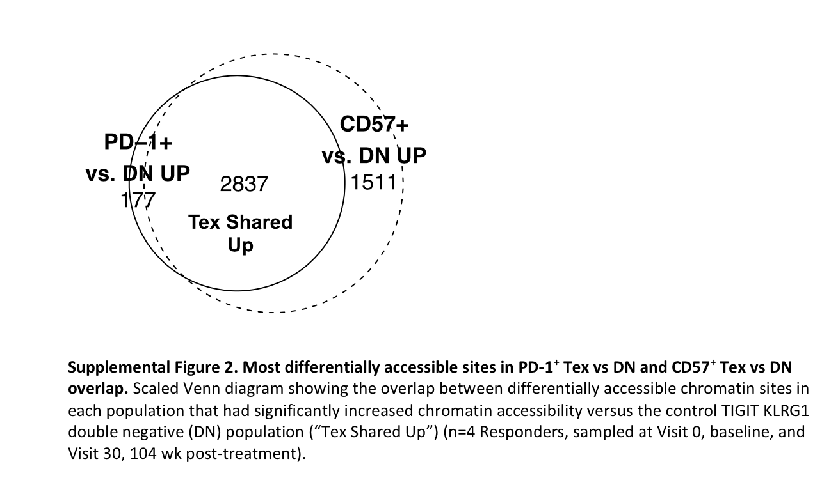
Difficult to determine which two DP populations are more closely related based on T_{ex} gene sharing
P452
P576
KIRs aren’t present in the unique to DP CD57⁺ fraction (not surprising, they don’t show up vs. DN, only vs. DP PD-1⁺)

Slide 7
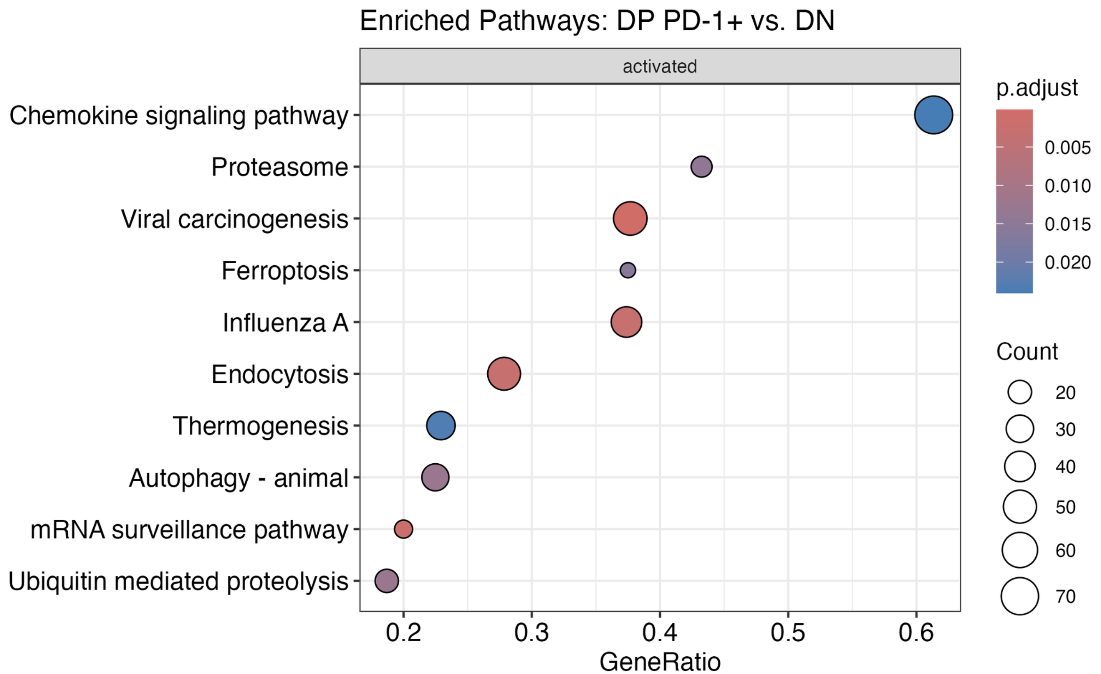
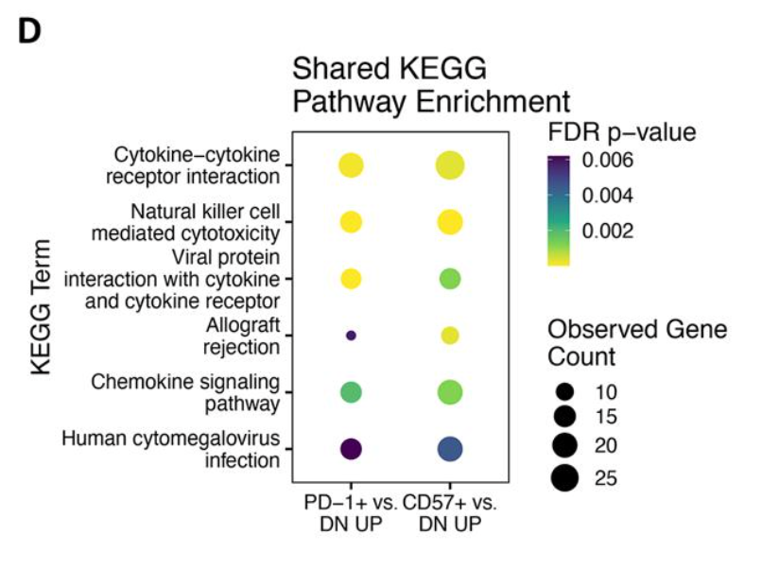
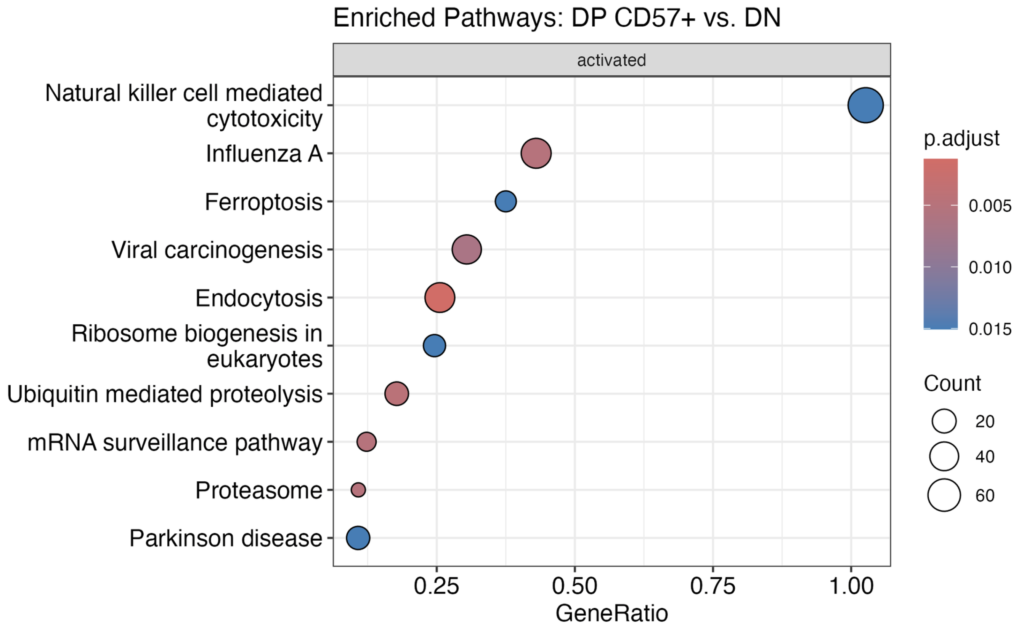
KEGG results are not very well reproduced, likely due to different methods
P452
P576

Slide 8
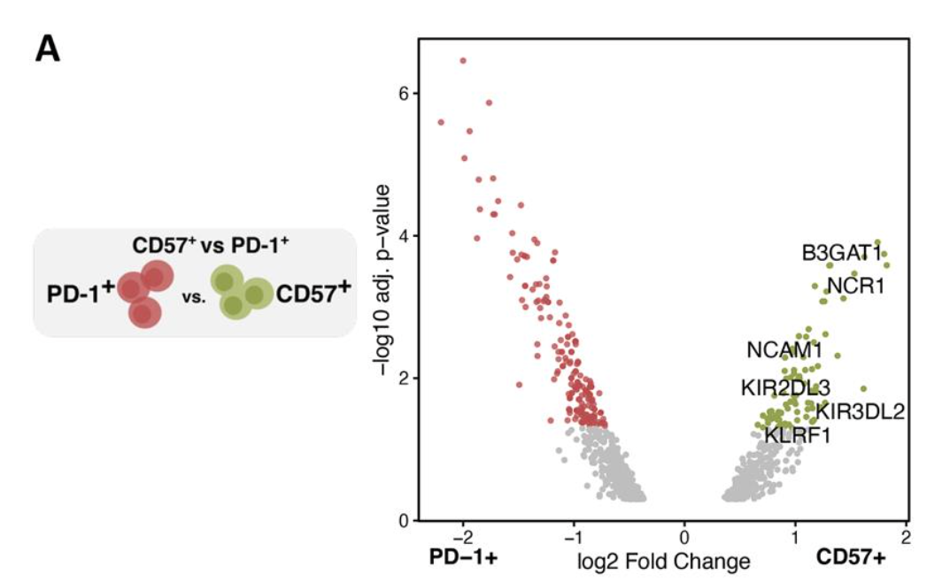
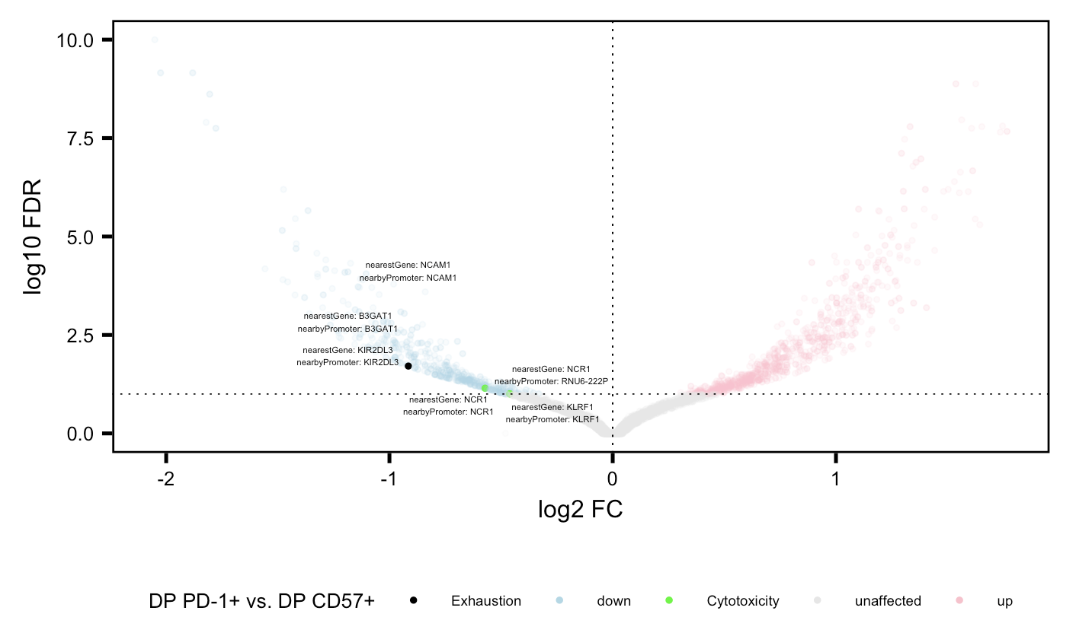
DP CD57⁺ vs. DP PD-1⁺ VP similar between projects
P452
P576

Slide 9
Volcano plots from other interesting DP vs DP

Slide 10
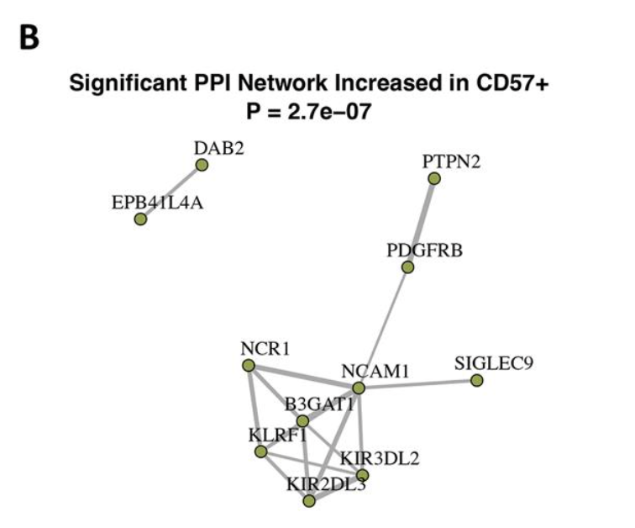
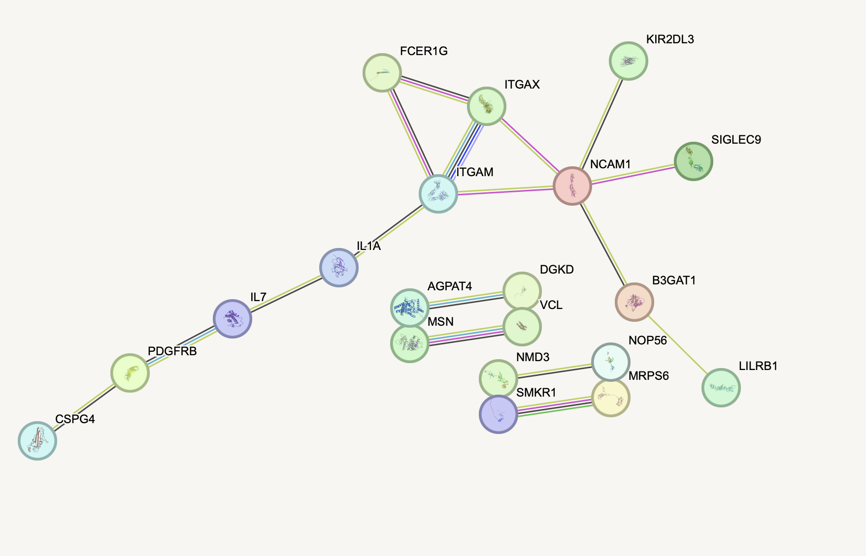
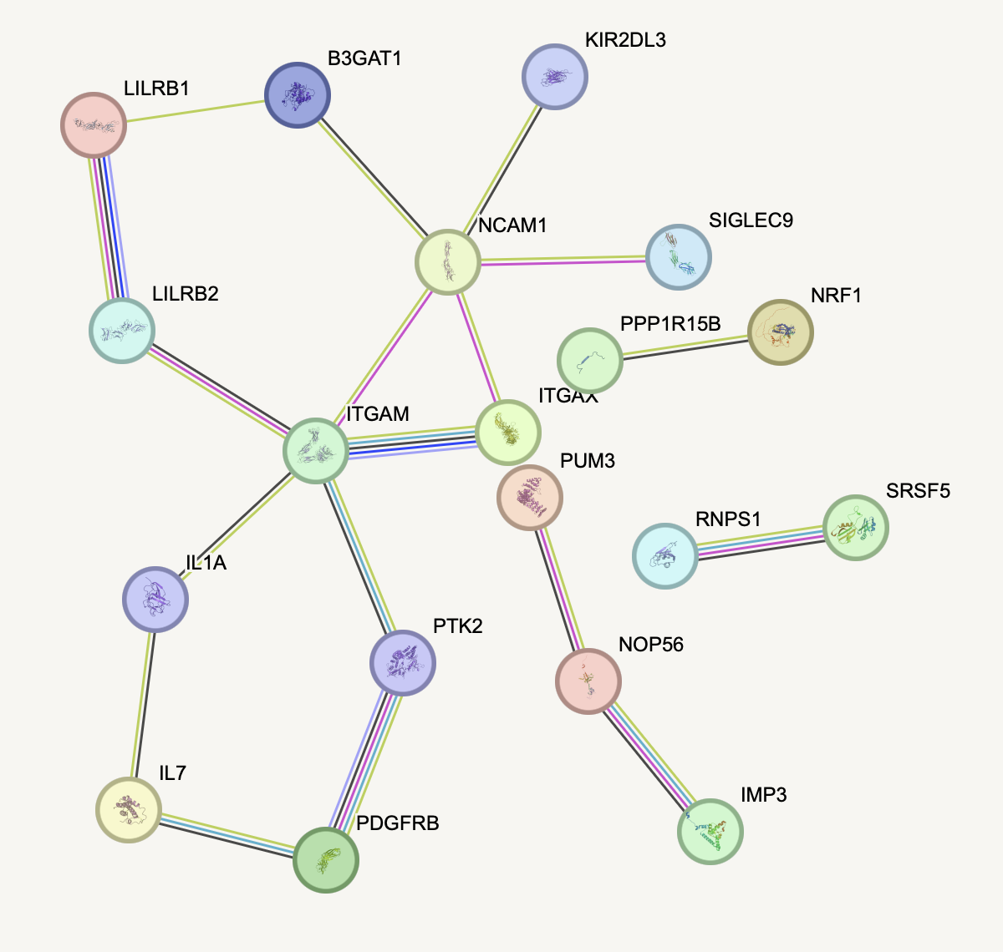
PPI network shows similar structure across projects for peaks up in DP CD57⁺ vs. DP PD-1⁺
Promoters, p = 0.004
Genes, p = 0.06
P452
P576
Notes:
Filtering for high confidence lowers p val I think

Slide 11
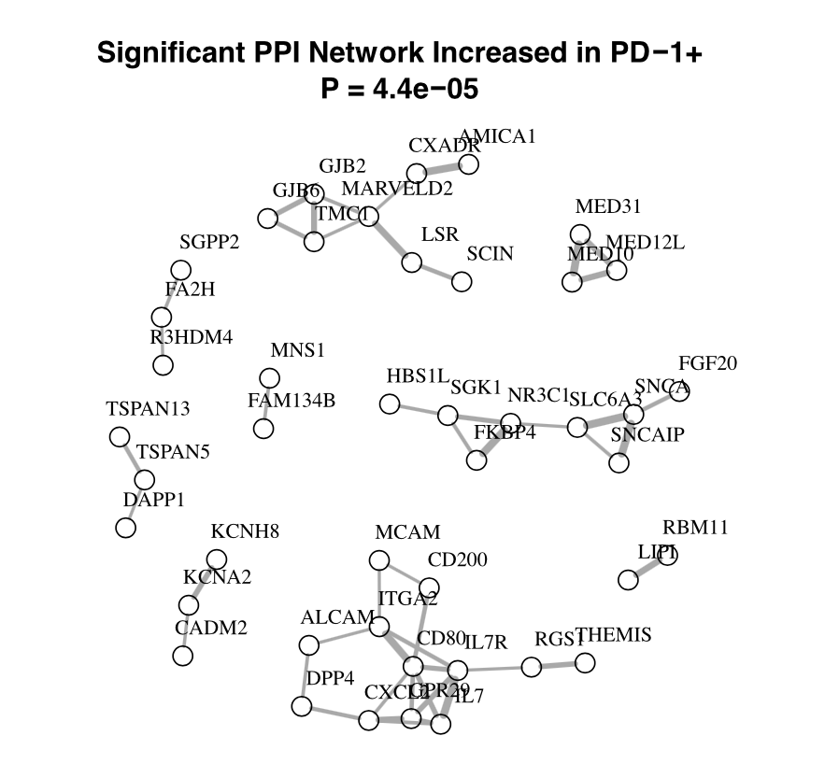
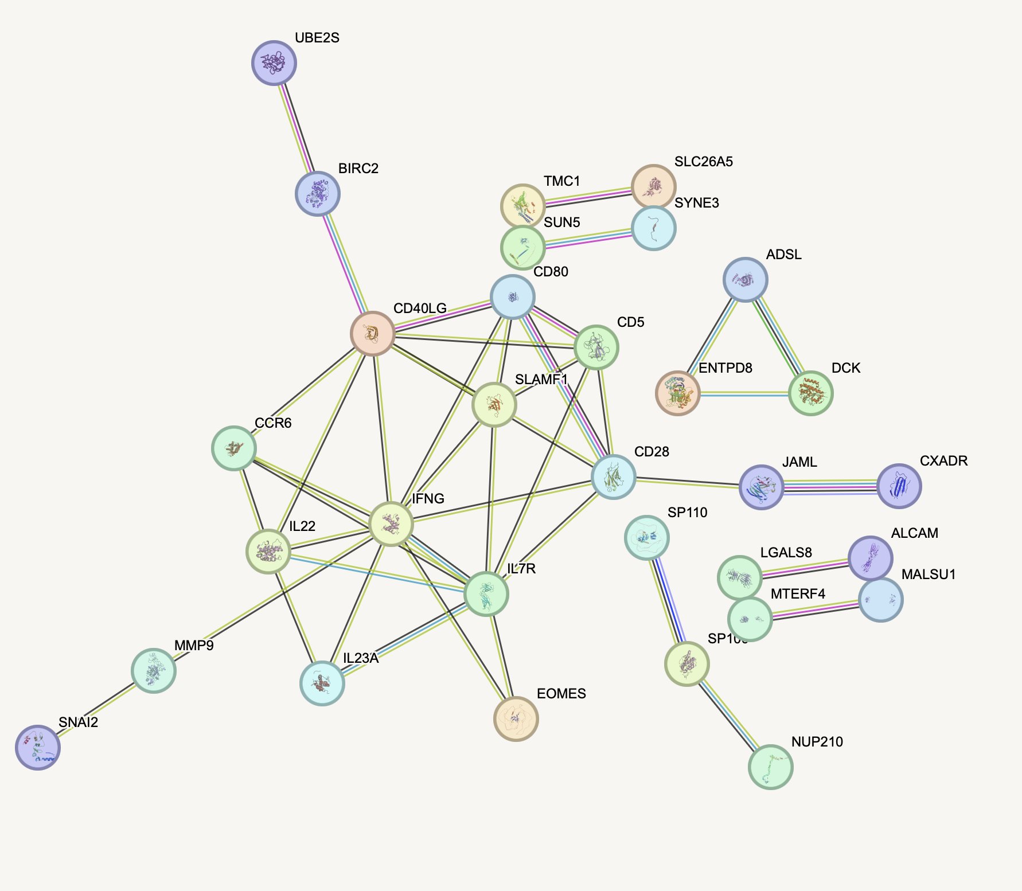
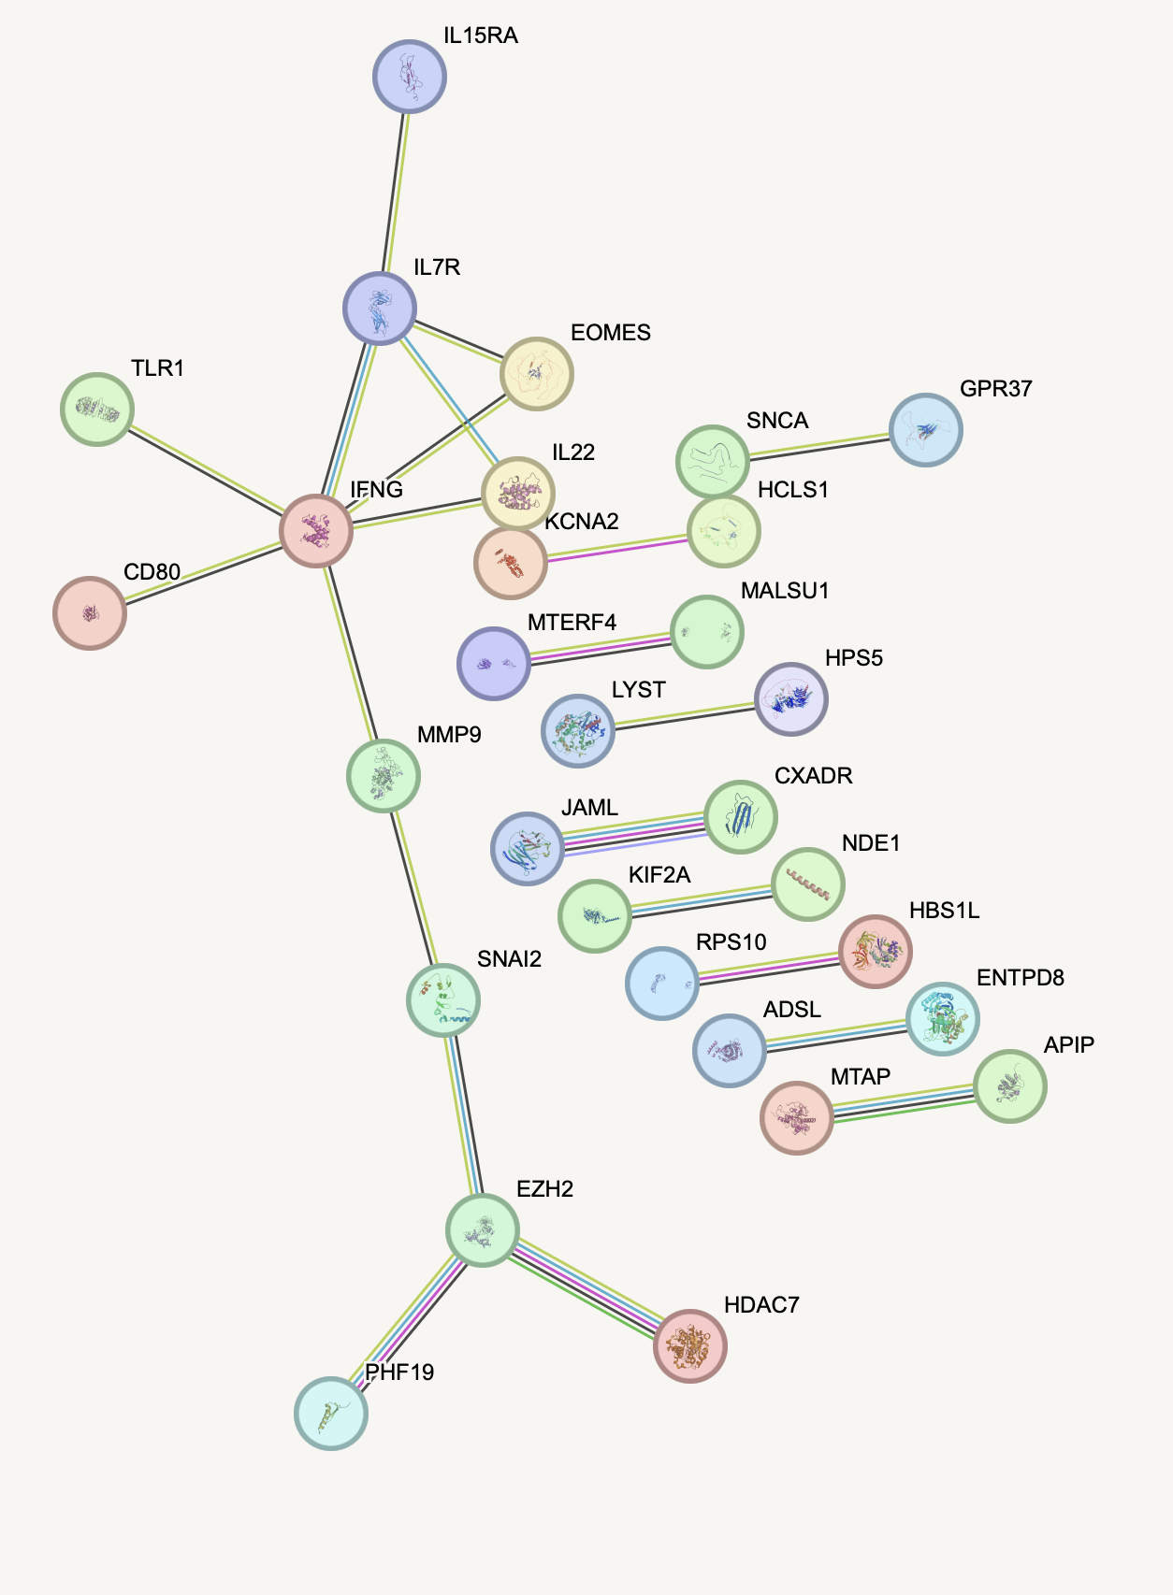
PPI network doesn’t show similar structure across projects for peaks up in DP PD-1⁺ vs. DP CD57⁺
Promoters, p = 0.049
Genes, p = 0.000105
P452
P576

Slide 12
PPIs from other interesting DP vs. DP

Slide 13
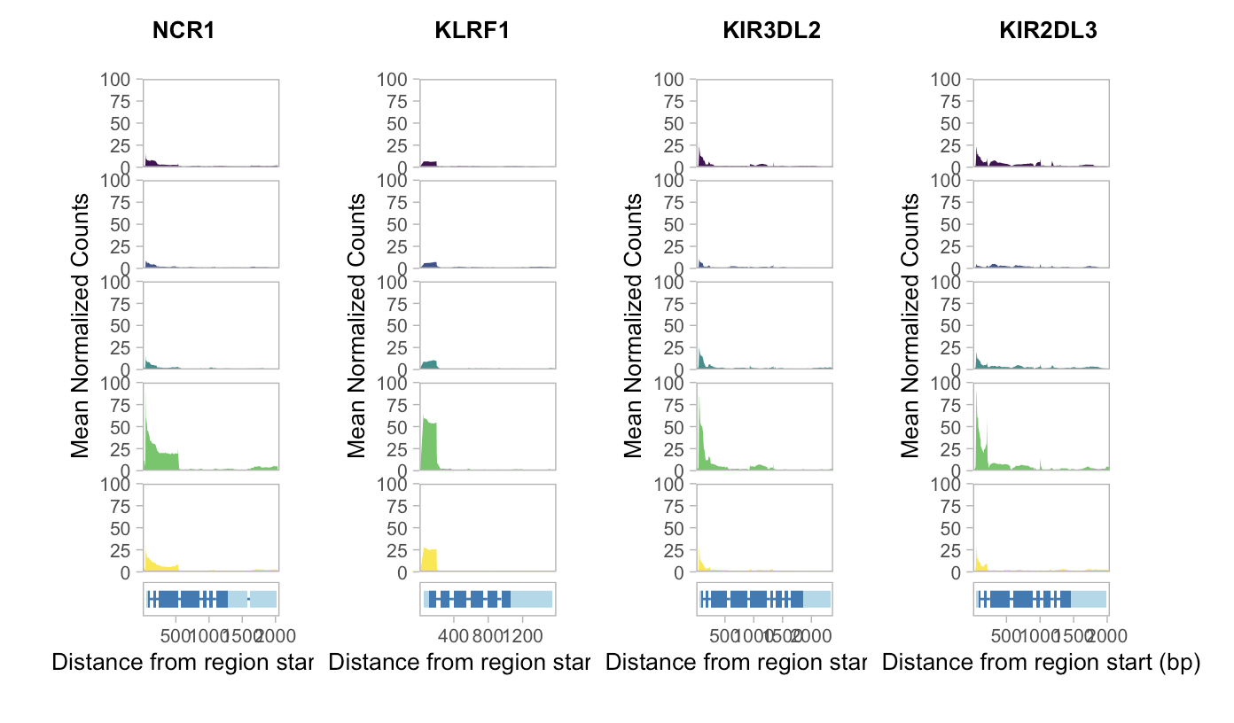
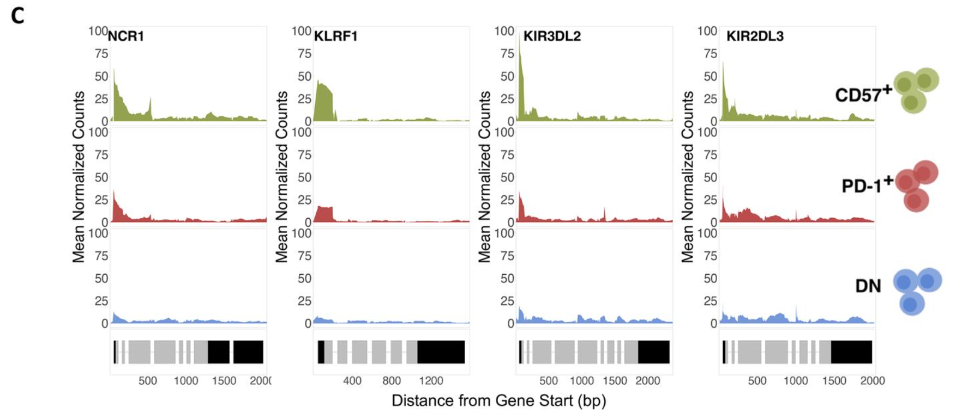
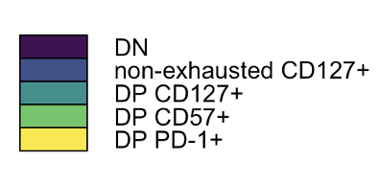
DP CD57⁺ accessible genes accessible in both projects

Slide 14
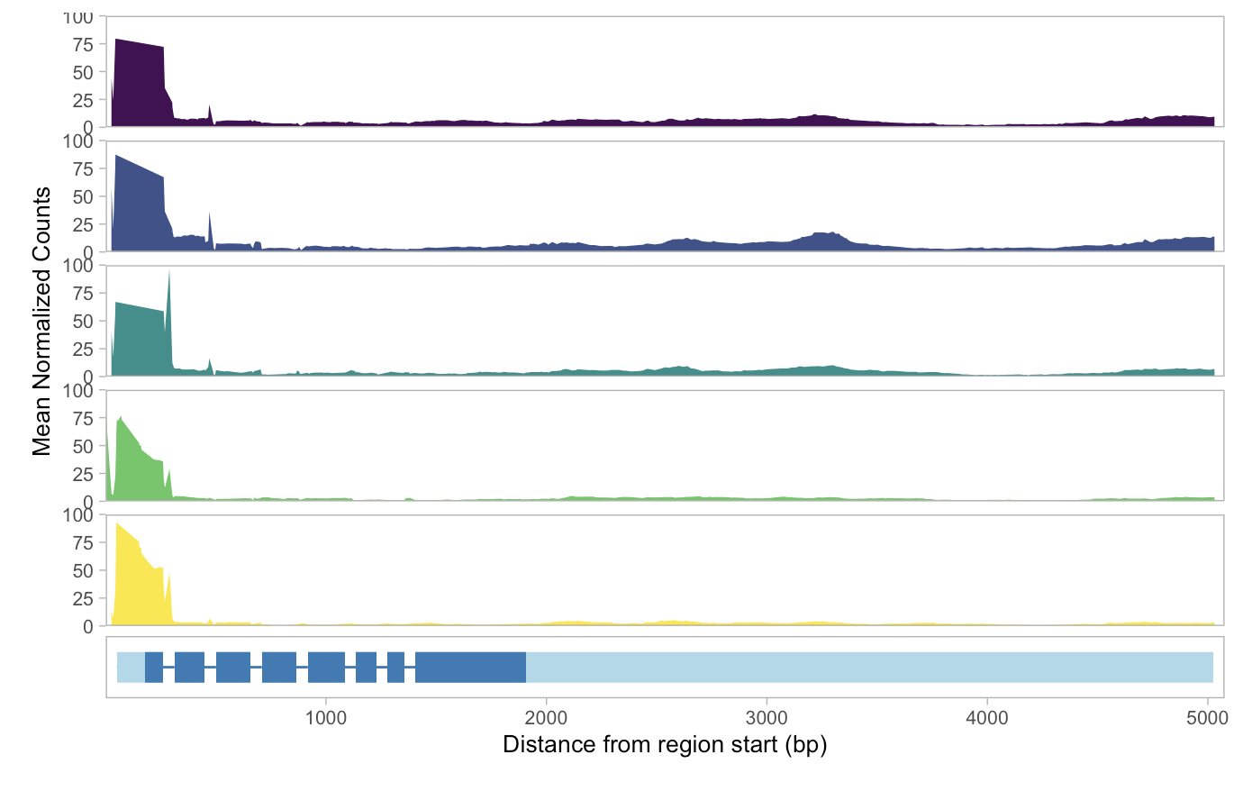
Start of CD127 gene similarly accessible in all populations, gene more accessible in DN and CD127⁺

Slide 15
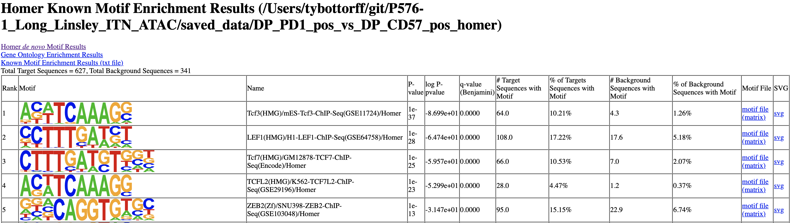
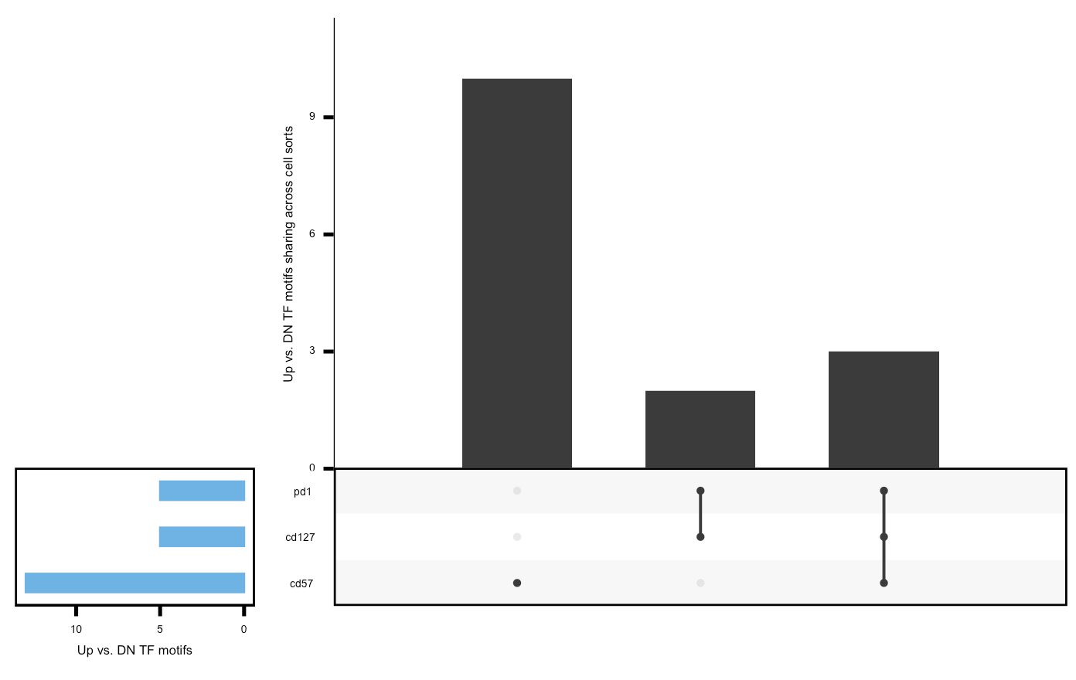
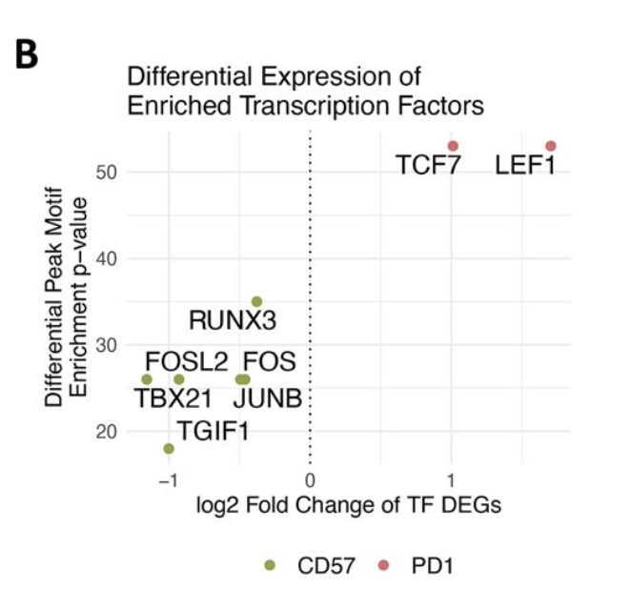
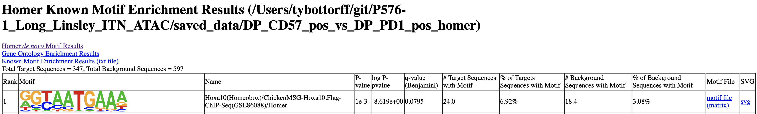

ERIN METHODS: De novo motif785 enrichment results were filtered to exclude all significant hits with a p-value > 1e-12 which were likely786 false positive results. Best matches identified by HOMER between de novo motifs and known motifs787 typically included several high-quality matches within the same TF motif family due to similar TF binding788 sites. Therefore, all potential matches of known motifs to significantly enriched de novo motifs were789 searched for in the list of DEGs between CD57+ Tex and PD-1+ Tex populations identified by scRNA-seq.790 The overlapping list of enriched TFs in accessible peaks and DEGs were plotted as a volcano plot showing791 their log2 fold change in gene expression and TF motif enrichment values calculated by HOMER
Re-do PD-1 vs. CD57 (and reverse) without -bg argument (re-compare vs. Erin’s) Upset TF plot(s)
And/or volcano (use fold enrichment for x?) IS THE FOLD ENRICHMENT THING WHY I WAS SEEING SAME TF IN BOTH DIRECTIONS FOR A CONTRAST? IE IN ONE IT HAD POS FOLD AND OTHER NEG FOLD?? De novo results too?
Filtered motifs for p < 1e-25
Background for motif discovery: peaks up in DN vs. each DP
(potentially fixes issue of same TF motif showing up in both up/down
peaks in a contrast)

Slide 16
Conclusions

Slide 17
Next steps

